Slide 1
AR_DETECTION ALGORITHM RESULTS

Slide 2
OBJECTIVE
To process ERA5 reanalysis data to identify Atmospheric Rivers (ARs)
Use Integrated Vapor Transport (IVT) to quantify and detect AR events
Calculate daily mean IVT and apply thresholds and conditions for detection

Slide 3
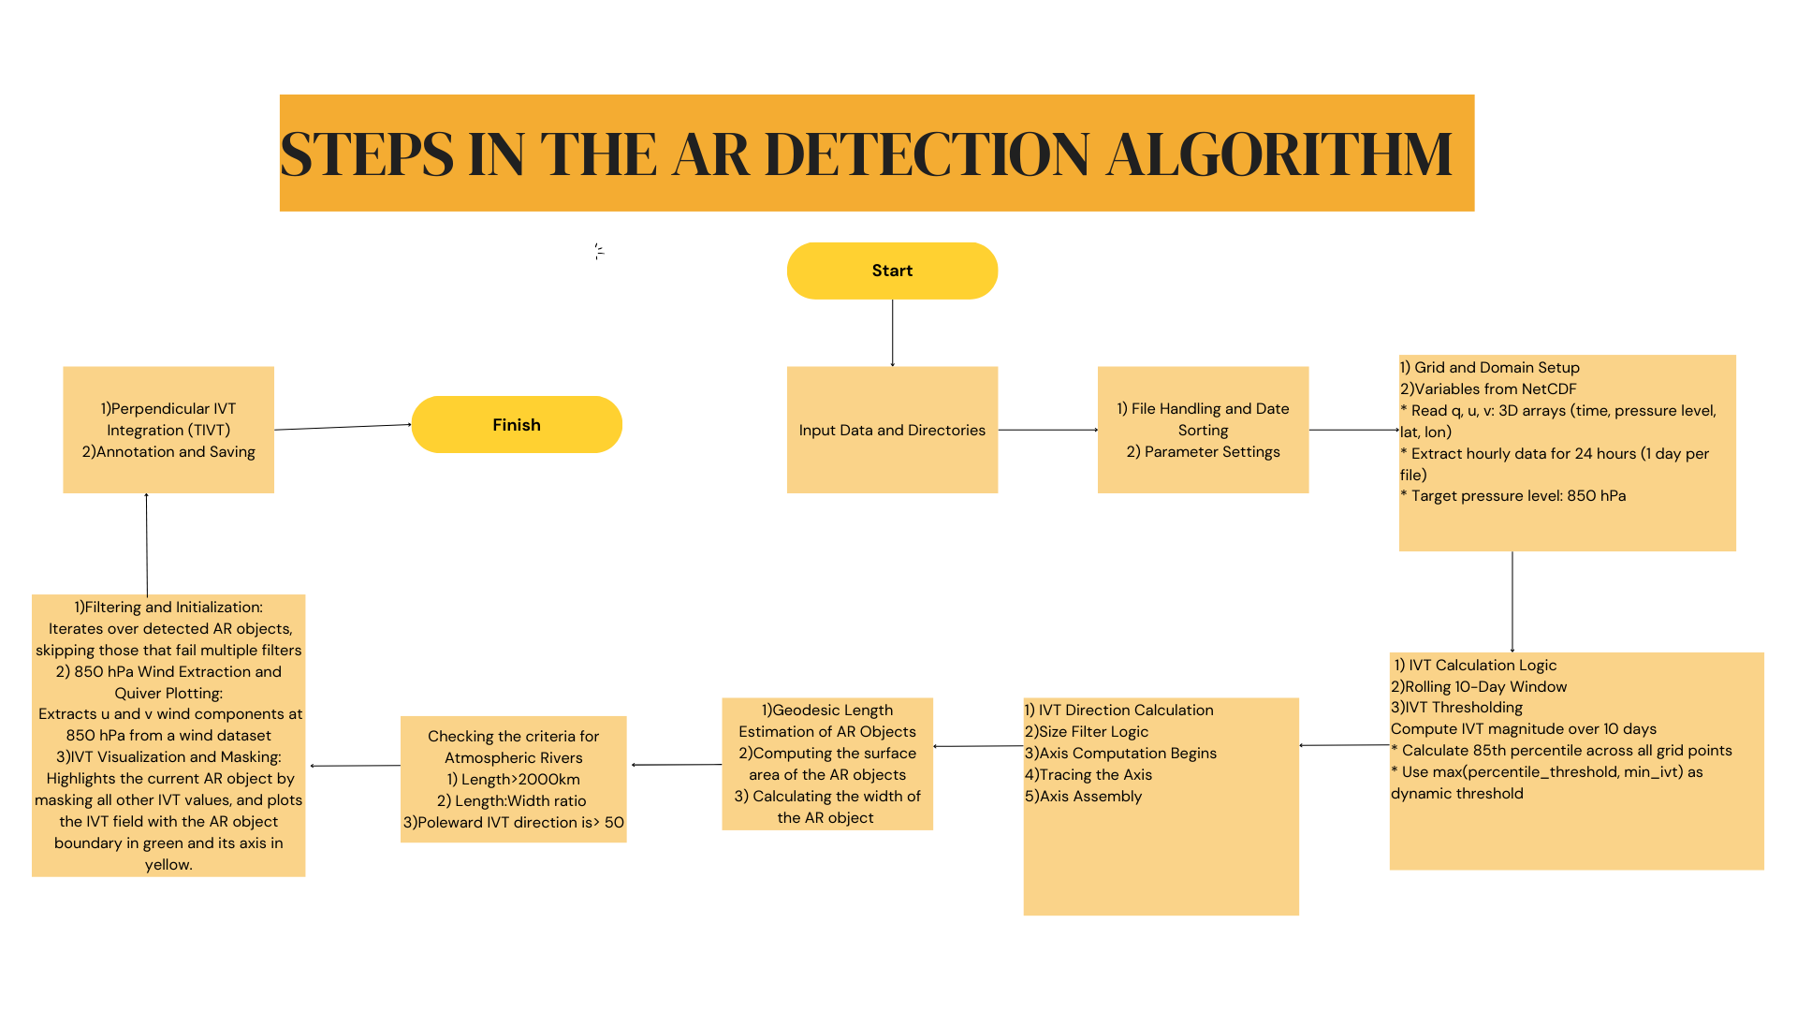

Slide 4
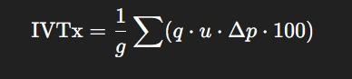
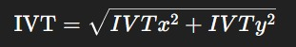
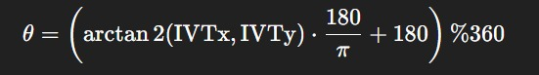
Important Formulae used(IVT Calculation)

Slide 5
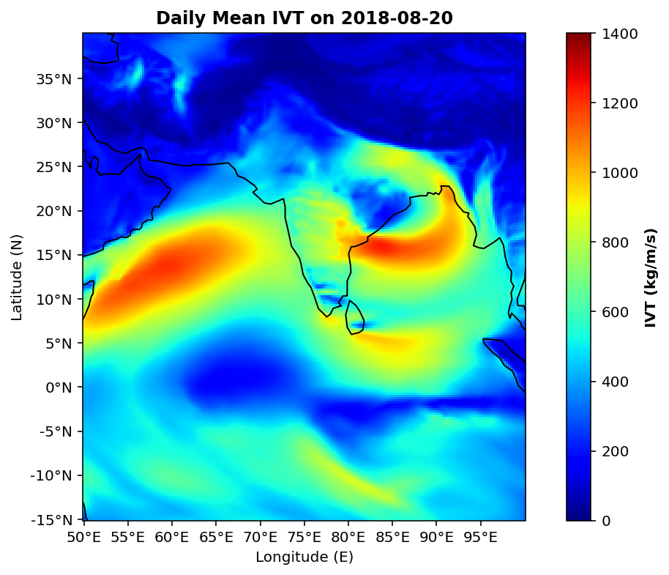
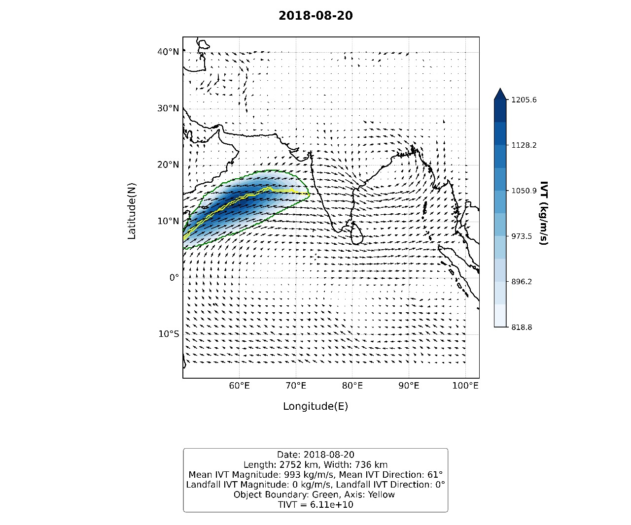
Date: 20th August 2018(AR Object 1)

Slide 6
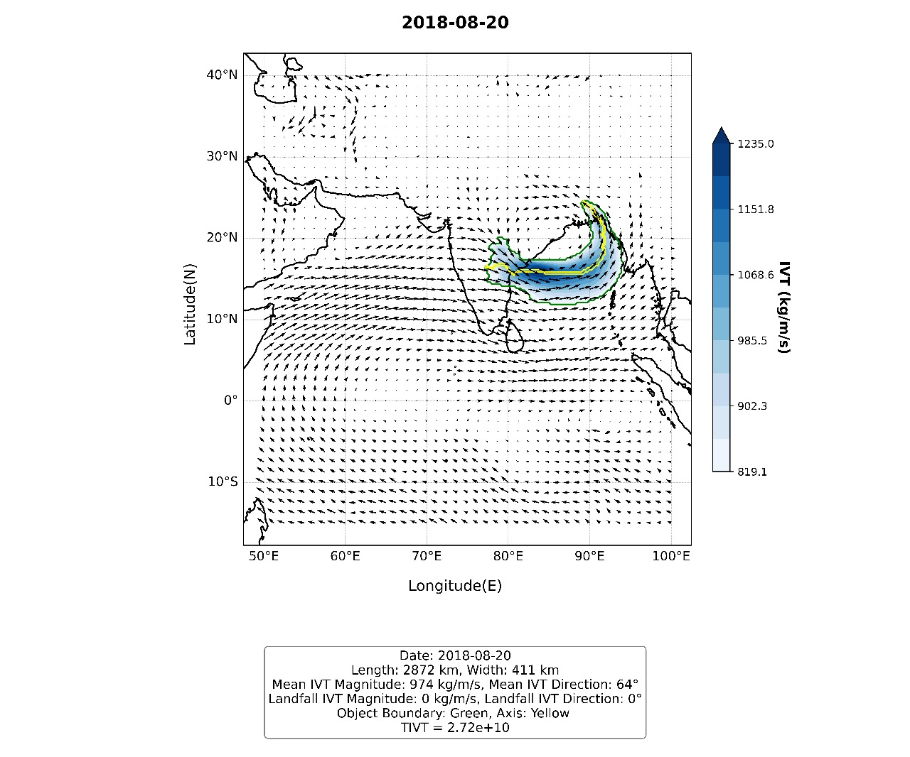
Date: 20th August 2018 (AR Object2)

Slide 7
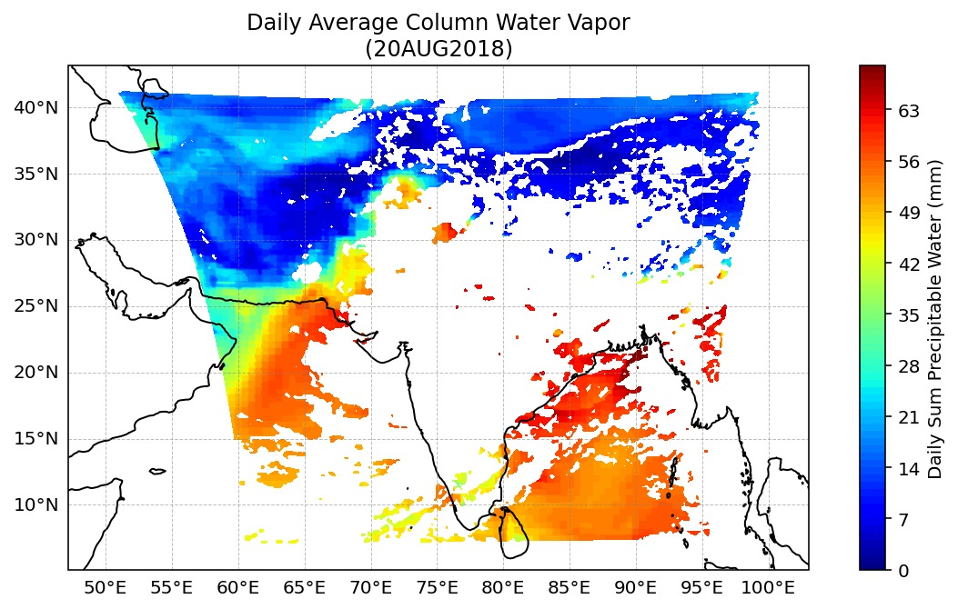
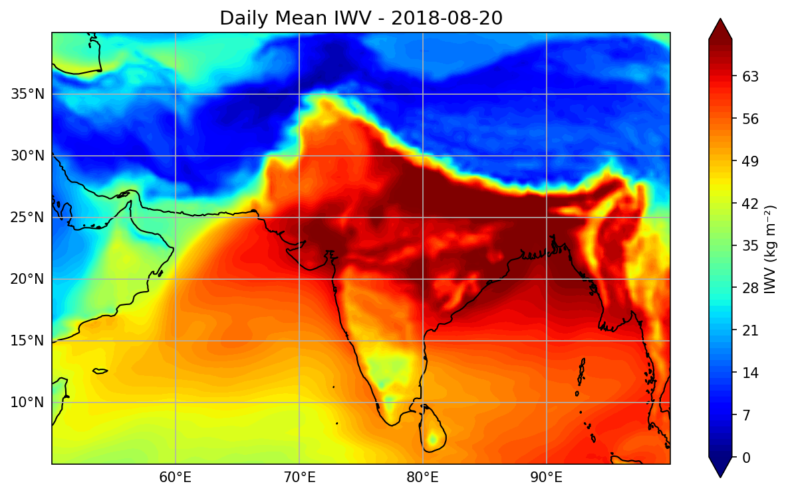

Slide 8
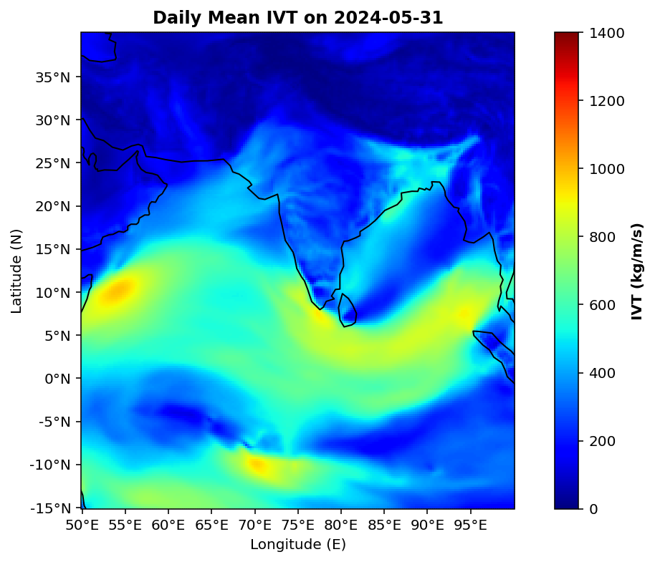
Date: 31st May 2024

Slide 9
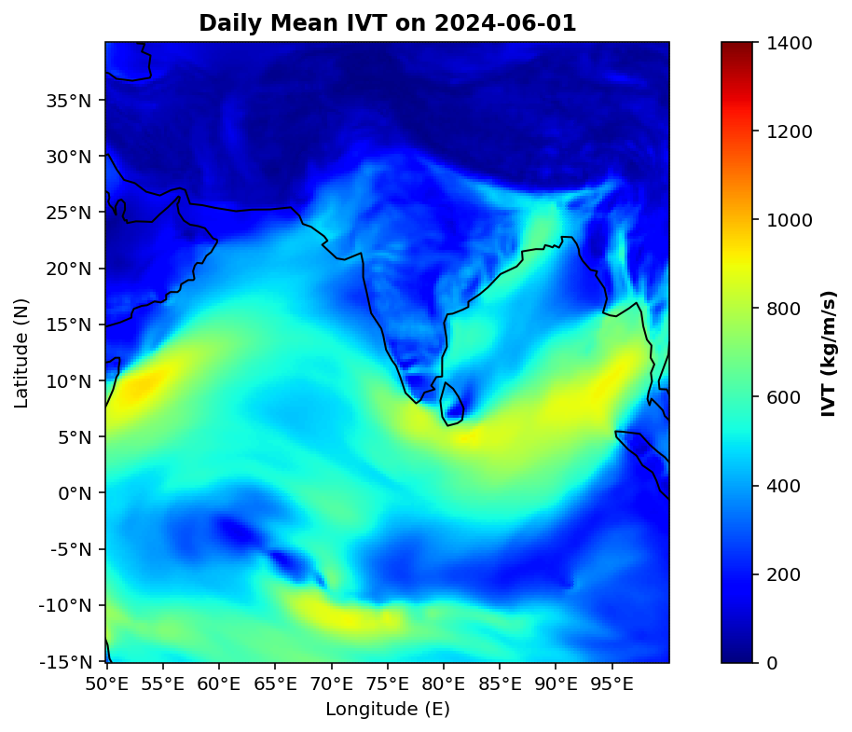
Date: 1st June 2024

Slide 10
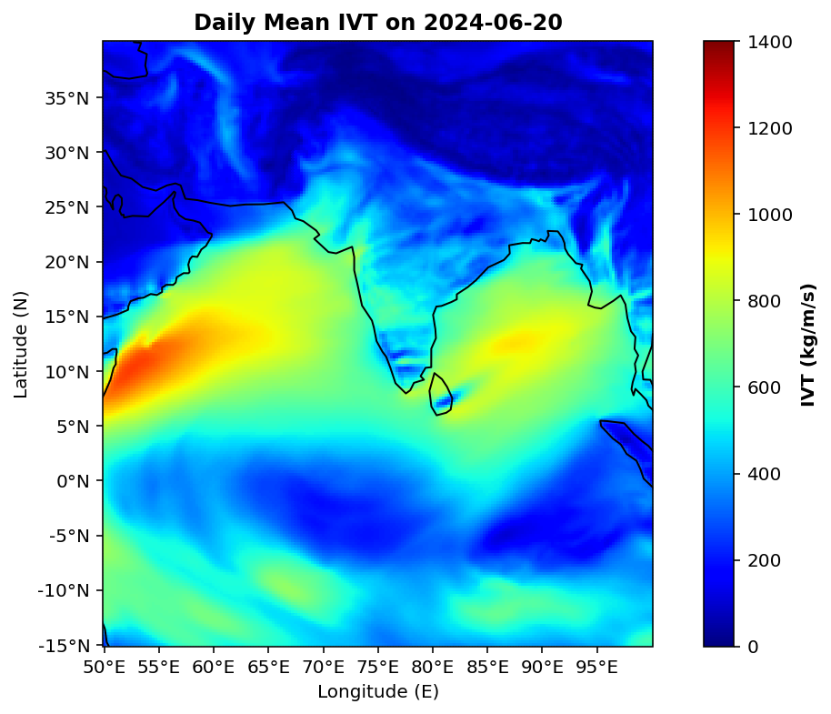
Date: 20th June 2024

